Slide 1



SHIELD INSURANCE ANALYSIS

Slide 2

AGENDA
01
Problem Statement
02
Objective
03
About Data
04
Dashboard
05
Insights & Recommmnedations

Slide 3

BACKGROUND OF SHIELD INSURANCE
01
02
03
Since 2017,Shield Insurance has been offering a variety of insurance plans for businesses and people of all ages.
04
06
07

Slide 4



Problem Statement
01
Product Development
02
Customer Insights

Slide 5
OBJECTIVE
01
Prepare a Power BI dashboard according to the client’s requirements.
Explain that dashboard using a video presentation.
02

Slide 6






Mumbai
Delhi NCR
Chennai
ABOUT DATA
There were 5 cities in which they were providing insurance to the customers.
Hyderabad
Indore

Slide 7

ABOUT DATA
Offline Agent
Offline Direct
The data available was from Nov,2022 to Apr,2023.
SALES MODE
Online App
Online Website

Slide 8




DASHBOARD
GENERAL VIEW
SALES MODE ANALYSIS
AGE GROUP ANALYSIS
This view highlights key KPIs for Shield Insurance, including Total Revenue,Total Customers,Daily Revenue Growth(DRG),Daily Customer Growth(DCG).It also represents monthly trends, revenue and customer splits by City, Age Group and Customer Segmententation, offering a clear overview of business performances.
This view focuses on the performance of different sales channels. It includes Revenue and Customer Splits by Sales Mode(online vs offline),along with monthly trends for each sales mode..
This view shows insights on age group vs policy preference, sales mode and expected settlement along with a monthly customer trend by age group and total customers by age group.

Slide 9
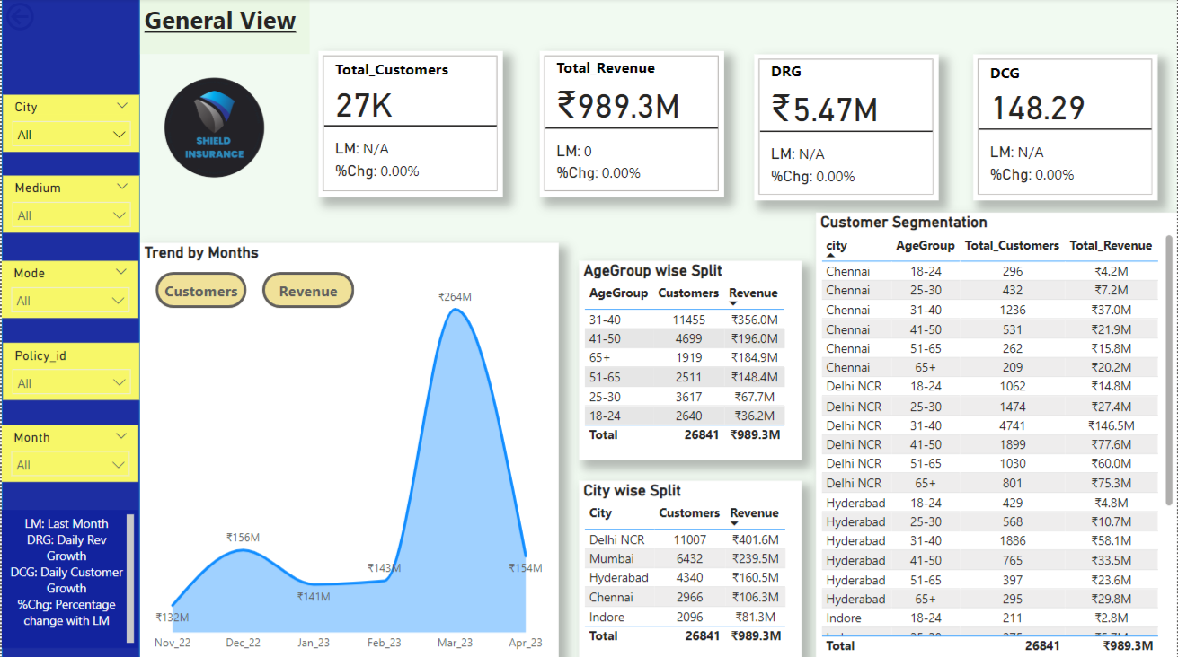

Slide 10
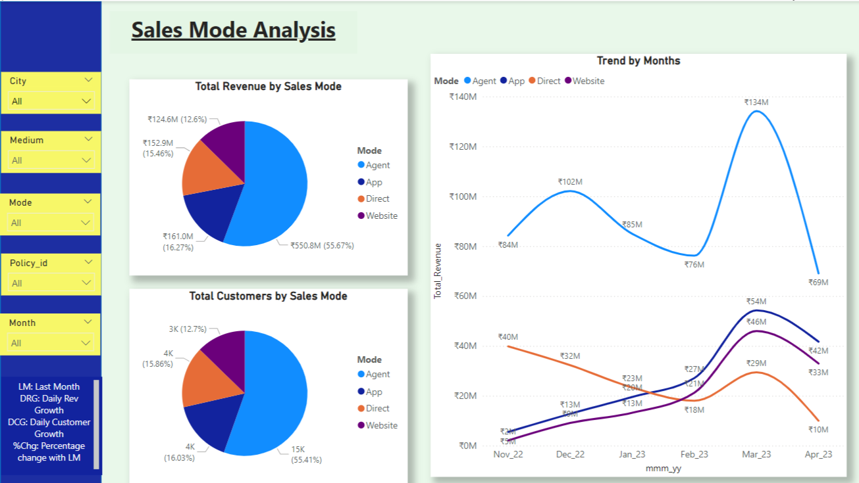

Slide 11
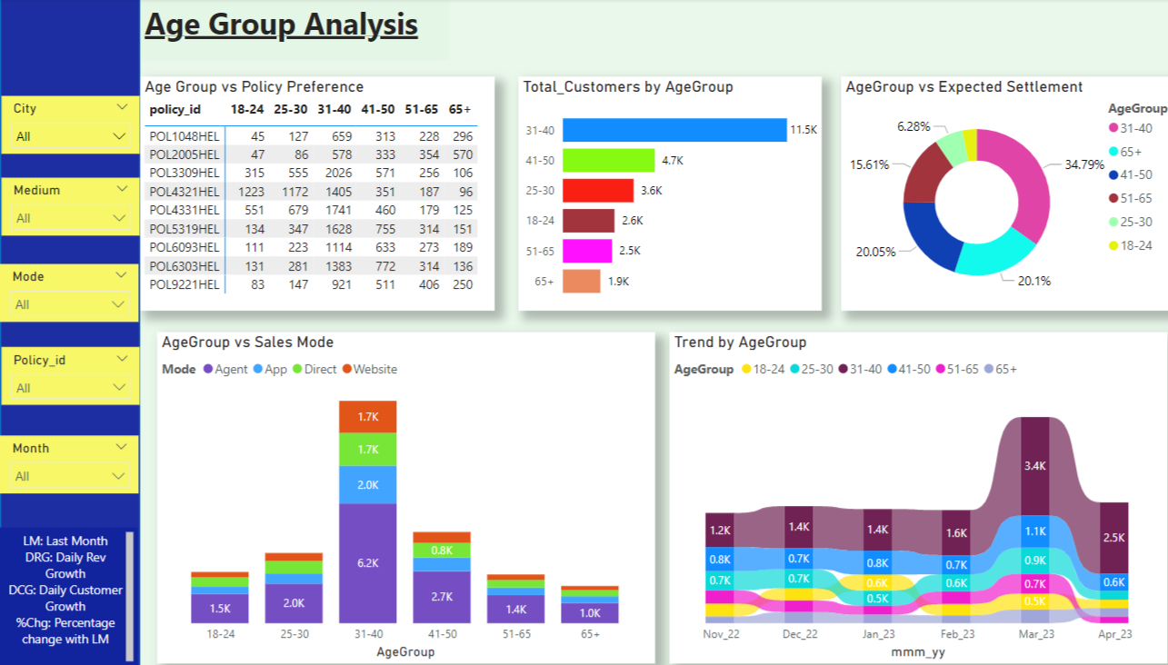

Slide 12
KEY PERFORMANCE INDICATORS
TOTAL REVENUE
TOTAL CUSTOMERS
The overall income generated from all policies sold during a specific period which reflects the company’s financial performance.
The total number of unique customers enrolled in Shield Insurance,representing the company’s base and market.
.
DAILY REVENUE GROWTH
DAILY CUSTOMER GROWTH
The daily percentage change in the revenue compared to the previous day, indicating growth trends.
.
The daily percentage change in the number of customers compared to the previous day, reflecting customer acquisition trends.

Slide 13
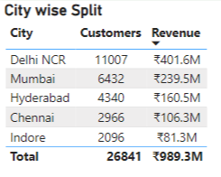
INSIGHT 1
Revenue & Customer Performance by City
Delhi NCR is the largest revenue contributor with ₹ 401.6 M and 11007 customers ,making it the most profitable region.
Indore is the least revenue contributor with
₹ 81.3M and 2096 customers ,making it the
least profitable region.

Slide 14
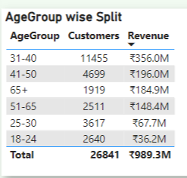
INSIGHT - 2
Revenue & Customer Performance by Age Group
The 31-40 age group is the top revenue generator with Rs. 356 M from 11455 customers.
The 41-50 age group follows with Rs. 196 M showcasing strong engagement from 4699 customers.
The 18-24 age group is the least revenue generator with Rs. 36.2 M and 2640 customers.

Slide 15
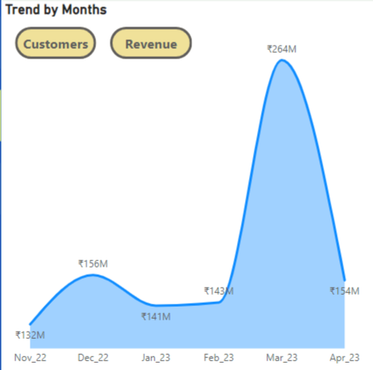
INSIGHT- 3
Revenue Trend by Months
Steady Start and Stability: Revenue showed steady growth from ₹ 132M in Nov '22 to ₹ 156M in Dec '22, followed by minor fluctuations around ₹141M-₹143M from Jan '23 to Feb '23.
March Surge: A significant spike in March '23 to ₹264M, marking the highest revenue, likely due to seasonal, promotional, or operational factors.
Post-Peak Decline: Revenue dropped to ₹154M in Apr '23, stabilizing slightly above pre-surge levels but significantly below the March peak.

Slide 16
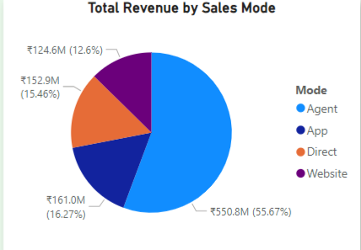
INSIGHT-4
Revenue Distribution by Sales Mode
The Agent mode contributes the largest share at 55.67% (₹550.8M), driving over half of total revenue.
Direct, App, and Website account for 16.27%, 15.46%, and 12.6%, respectively, with room for growth in digital channels.
Digital channels (App and Website) collectively contribute 28.06%, indicating potential for further investment to diversify revenue streams.

Slide 17
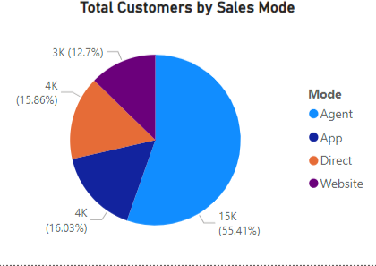
INSIGHT -5
Customer Distribution by Sales Mode
The majority of Shield Insurance’s Sales are generated through Agents, accounting for 55.41% of total sales.
Other modes include App(16.03%),Direct(15.86%) and Website(12.70%),showing that offline channels(Agent and Direct) still plays a significant role in sales.

Slide 18
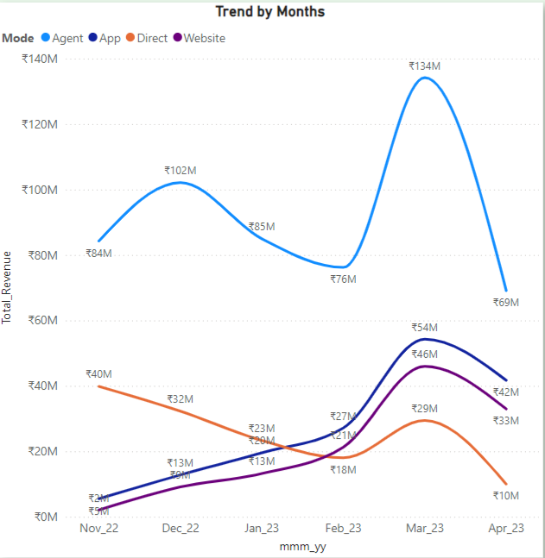
INSIGHT-6
Monthly Revenue Trends
The Agent mode consistently outperforms other modes in terms of total revenue, peaking significantly in March 2023 (₹134M). However, its revenue sharply declines to ₹69M in April 2023.
The Website mode shows a steady upward trend, surpassing Direct mode in February 2023 and maintaining its position as the second-highest revenue contributor by April 2023 (₹42M).
The Direct mode exhibits a significant downward trend, starting at ₹40M in November 2022 and declining to ₹10M by April 2023, indicating a potential shift in customer preference or inefficiency in this channel.

Slide 19
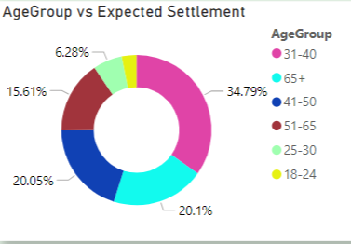
INSIGHT-7
Expected Settlements by Age Group
The age group 31-40 holds the largest share of expected settlements at 34.79% ,which might imply higher risk or claim activity within this group.
25-30 and 41-50 age groups also show notable settlement expectations, at 20.05% and 20.1% respectively ,which could inform risk assessment and policy management strategies.

Slide 20
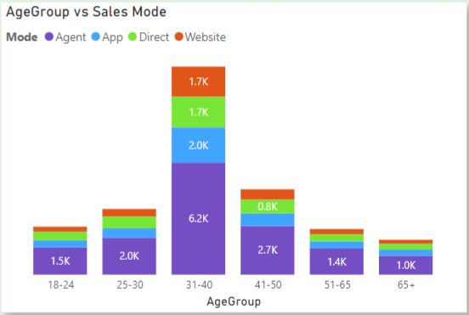
INSIGHT-8
Age Group vs Sales Mode
The 31–40 age group generates the highest sales (6.2K from Agent mode alone), outperforming all other age groups. This age group likely has stable income, more purchasing needs (family-focused), and may prefer Agent mode for reliability and trust.
Sales decrease significantly in the 51–65 and 65+ age groups, with total sales falling below 2K.It may be because older individuals may have fewer consumption needs and are less likely to explore digital modes of purchase.

Slide 21
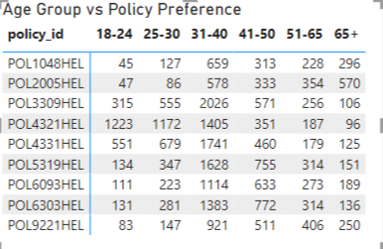
INSIGHT-9
Policy Preference by Age Group
Policies are well distributed among age groups ,with the 31-40 segment having the highest preferences for policies like POL9221HEL and POL3193HEL,indicating popular choices among this demographic.

Slide 22
Recommendations
Boost sales in Delhi NCR with loyalty programs and upselling, while improving performance in Indore with targeted campaigns and customer research to drive growth across all cities.
Focus on maximizing revenue from the 31–40 and 41–50 age groups with tailored offers, while attracting 18–24-year-olds through affordable products and digital marketing.
Invest in strengthening digital channels (App and Website) to diversify revenue streams and reduce dependence on the Agent mode.
Develop tailored policies for high settlement groups(31-40,25-30,41-50) to improve risk management.
Customize product offerings by age group to match preferences and optimize multi channel engagement.

